Slide 1
EECE 71030 – Winter 2024
Week 3 – Caesar Cipher

Slide 2
Cryptography
The goal is to send secure messages over an insecure medium
Using a key alongside an algorithm turn plaintext to ciphertext
Cryptography: Creating / making secure messages
Turn plaintext to ciphertext
Cryptology: Breaking secret messages
Turn ciphertext to plaintext

Slide 3
Cryptography
Confidentiality
Prevent someone from eavesdropping or reading someone's messages
Integrity
Prevent and attacker from modifying messages without being detected
Authenticity
Prevent an attacker from impersonating someone

Slide 4
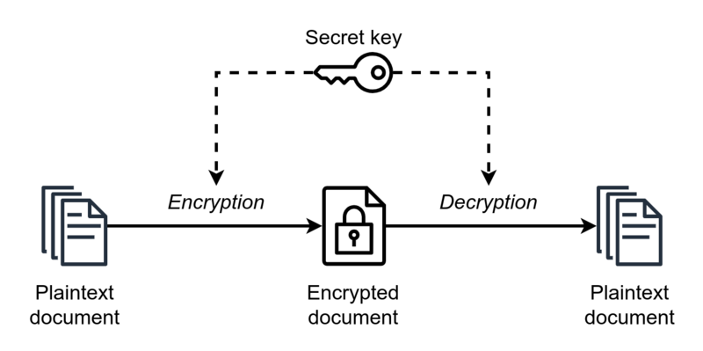
Secret-key encryption
Also known as “Symmetric Encryption”
Reference: https://upload.wikimedia.org/wikipedia/commons/thumb/6/61/Simple_symmetric_encryption.png/800px-Simple_symmetric_encryption.png

Slide 5
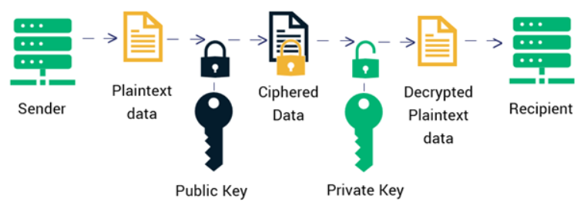
Public-key encryption
Also known as “Asymmetric Encryption”
Reference: https://sectigostore.com/blog/what-is-asymmetric-encryption-how-does-it-work/

Slide 6
Public-key encryption
In public-key encryption, there are two keys involved: a public key and a private key.
The public key you can share it with anyone
Anyone who wants to send you a message will use this key to encrypt the message
The private key must NEVER be shared
The private key is used to unlock the messages that were locked with your public key.

Slide 7
Public-key encryption
Secure Communication: Public-key encryption ensures secure communication over otherwise unsecure communication channels.
Data Privacy: Allows individuals to control who can access their information.
Authentication: Allows users to verify the identity of the sender.
Data Integrity: Helps ensure data integrity by allowing the recipient to confirm that the data received has not been altered during transit.

Slide 8

Caesar Cipher
Simple message encrypting algorithm
Developed and used by Julius Caesar for encrypted communication
Type of “Substitution Cipher”
Reference: https://en.wikipedia.org/wiki/Caesar_cipher

Slide 9
Caesar Cipher - Encoder
C = E (P, k)
C = Ciphertext
P = Plaintext
k = key (in this case shift value)
C = (P + k) mod 26

Slide 10
Caesar Cipher - Decoder
C = E (P, k)
C = Ciphertext
P = Plaintext
k = key (in this case shift value)
P = (C - k) mod 26

Slide 11
Caesar Cipher – Pros and Cons
Pros | Cons
Easy to implement | Relatively easy to decode
Low memory footprint | Low Security
Easy to update key | Nomenclature

Slide 12
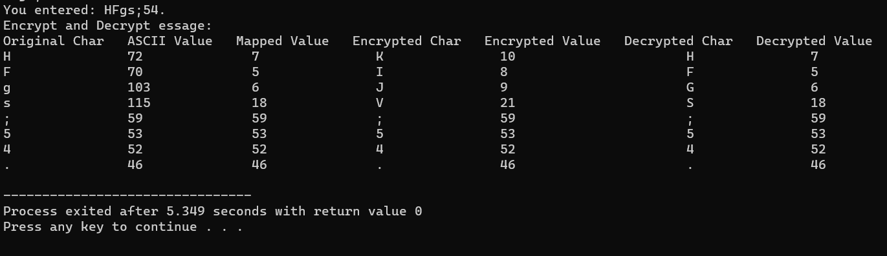
Assignment Sample Output

